Slide 1
Bangalore House Price Project
By Using K-nearest Neighbours (KNN)

Slide 2
Objective :
Objective of this Bangalore house prediction is to predict house prices in Bangalore by using property feature like size , location , number of Bath Other Amenities room , Area (sqft). Provide insight for buyer , sellers and real estate agent
In this we use K-Nearest Neighbors (KNN) Regression model for prediction

Slide 3
Solution:
Data set overview :
data : Bangalore house price prediction.csv
In this project we use K-Nearest Neighbours (KNN)
Columns : 108
Dependent columns : price Independent columns : size , location , number of Bath Other Amenities room , Area (sqft
K-Nearest Neighbours (KNN) :
Data processing :
Collected and cleaned the house prediction data
Spilt the data set into training and testing and trained the model using multiple value k (1 TO 84)

Slide 4
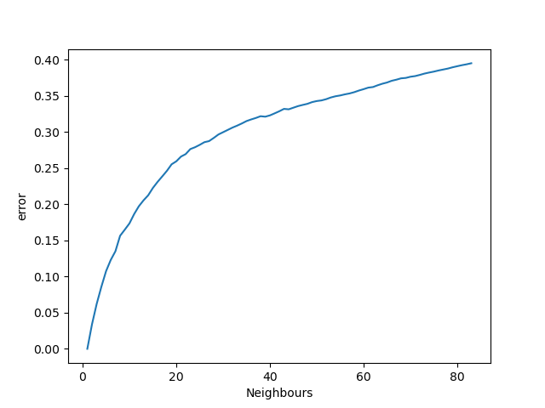
Graph summary :
In the graph x –axis is number of neighbors (1 to 84) and y-axis is error .In graph error increases as the number of the number of neighbors increase that indicates overfitting in low k and underfitting in high k values . an optimal range of 5–15 neighbors was identified

Slide 5
Model evaluation :
Evaluated the model using R2core and MSE
Also evaluated minimum error in model
And created the viz to study error trend
Accuracy of the model is : 94 %

Slide 6
Business impact :
Provides realistic property valuations, which helps buyers and sellers make confident decisions.
Helps real estate agents build data-backed pricing strategies.
Reduces price mismatch and negotiation overhead in property transactions.
Connects the technical outcome with business outcomes like increased customer trust, faster sales cycles, and market competitiveness

Slide 7
Thank you !

